Slide 1
Introduction to big data and advanced analytic techniques
Thuc Le
Advanced Analytic Techniques 2
University of South Australia

Slide 2
Agenda
Course outline, assessments, and communication
Big data: introduction and motivation
Data science, (big) data scientists
Use cases

Slide 3
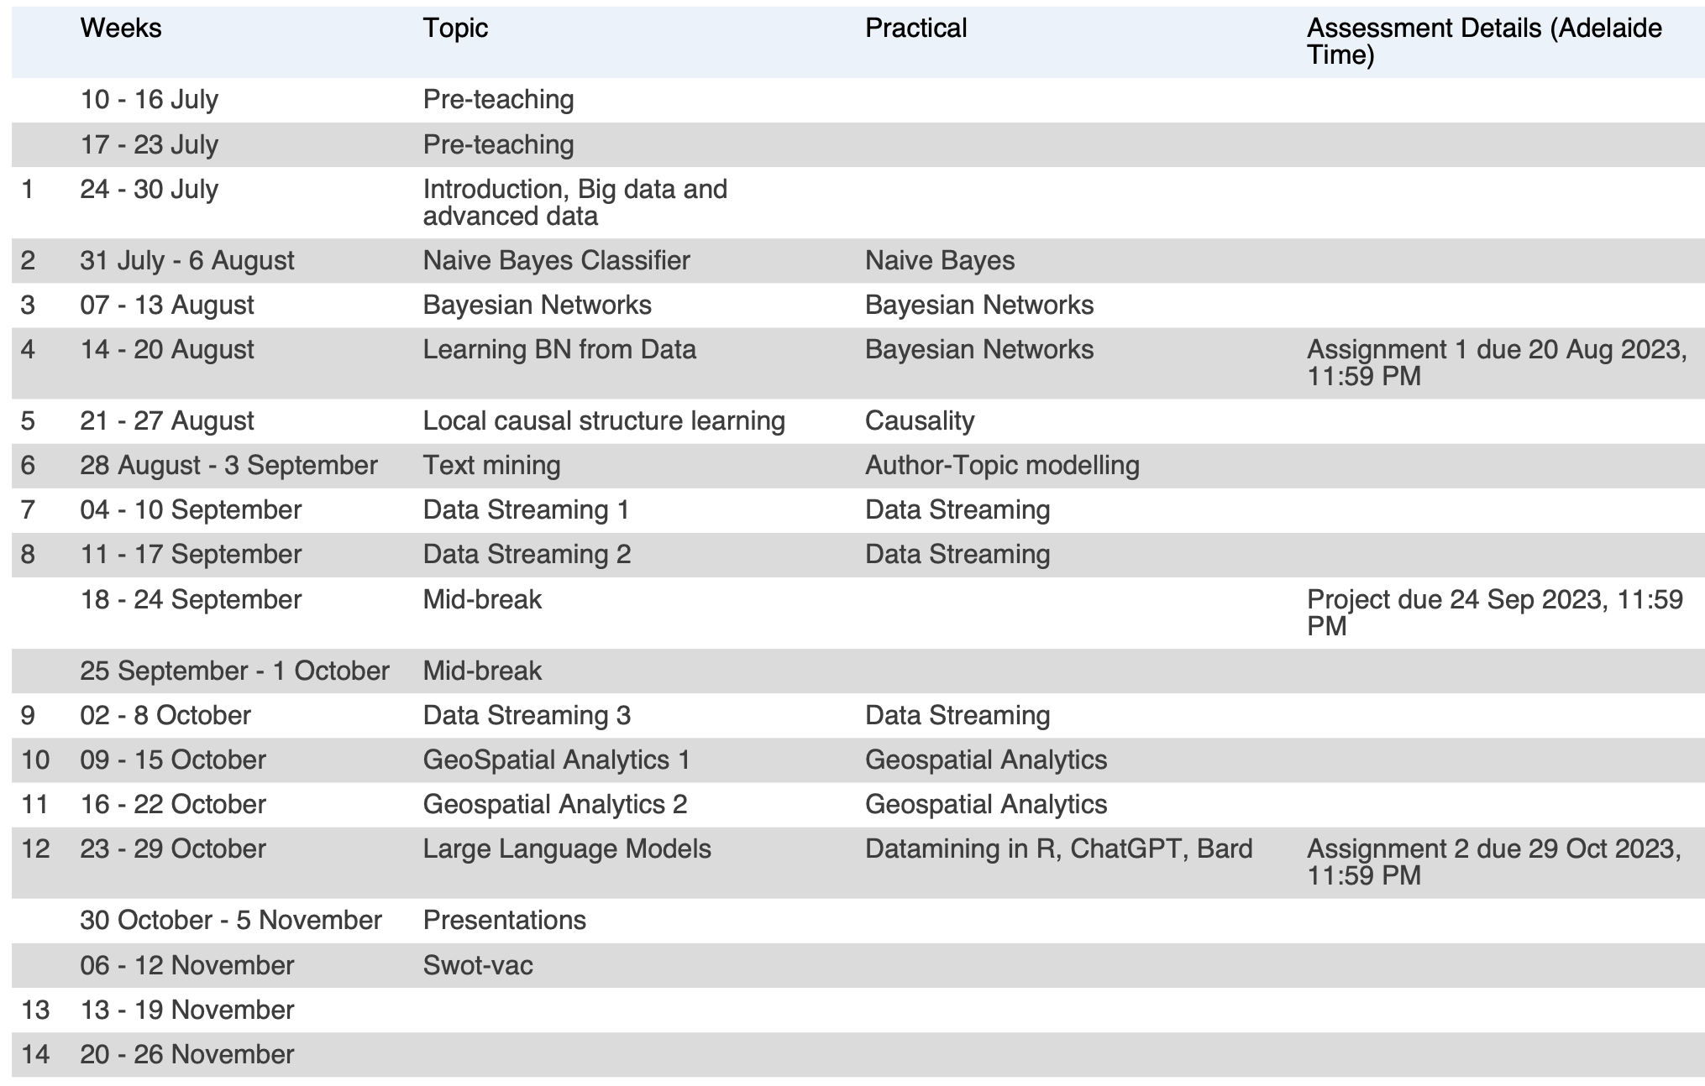
Advanced Analytic Techniques 2

Slide 4
Contents: lectures
Big data & data science introduction: week 1
Naïve Bayes Classifiers: week 2
Bayesian networks: week 3, 4, 5
Bayesian network structure learning
Causal inference
Local causal structure learning
Text mining: week 6
Streaming data: week 7, 8, 9
Geospatial analytics: week 10, 11
Experiment design: week 12

Slide 5
Contents: Practicals
Weka: http://www.cs.waikato.ac.nz/ml/weka/downloading.html
R: https://www.r-project.org/
Rstudio: https://www.rstudio.com/

Slide 6
Assessments
Assignment 1: Big data & Naïve Bayes classifiers
30%
Deadline: 20/08/2023
Project: Bayesian networks
40%
Deadline: 24/09/2023
Assignment 3: text mining, geospatial, streaming data
30%
Deadline: 29/10/2023

Slide 7
Communication
Discussion forum
My office: D3-14 (please send me an email first)
Email: Thuc.Le@unisa.edu.au
More about me and my research: Thuc Le
https://people.unisa.edu.au/thuc.le

Slide 8
Learning tips
Commitment
Seek help (if you cannot google)
Additional resources
Warning: This is an advanced course

Slide 9
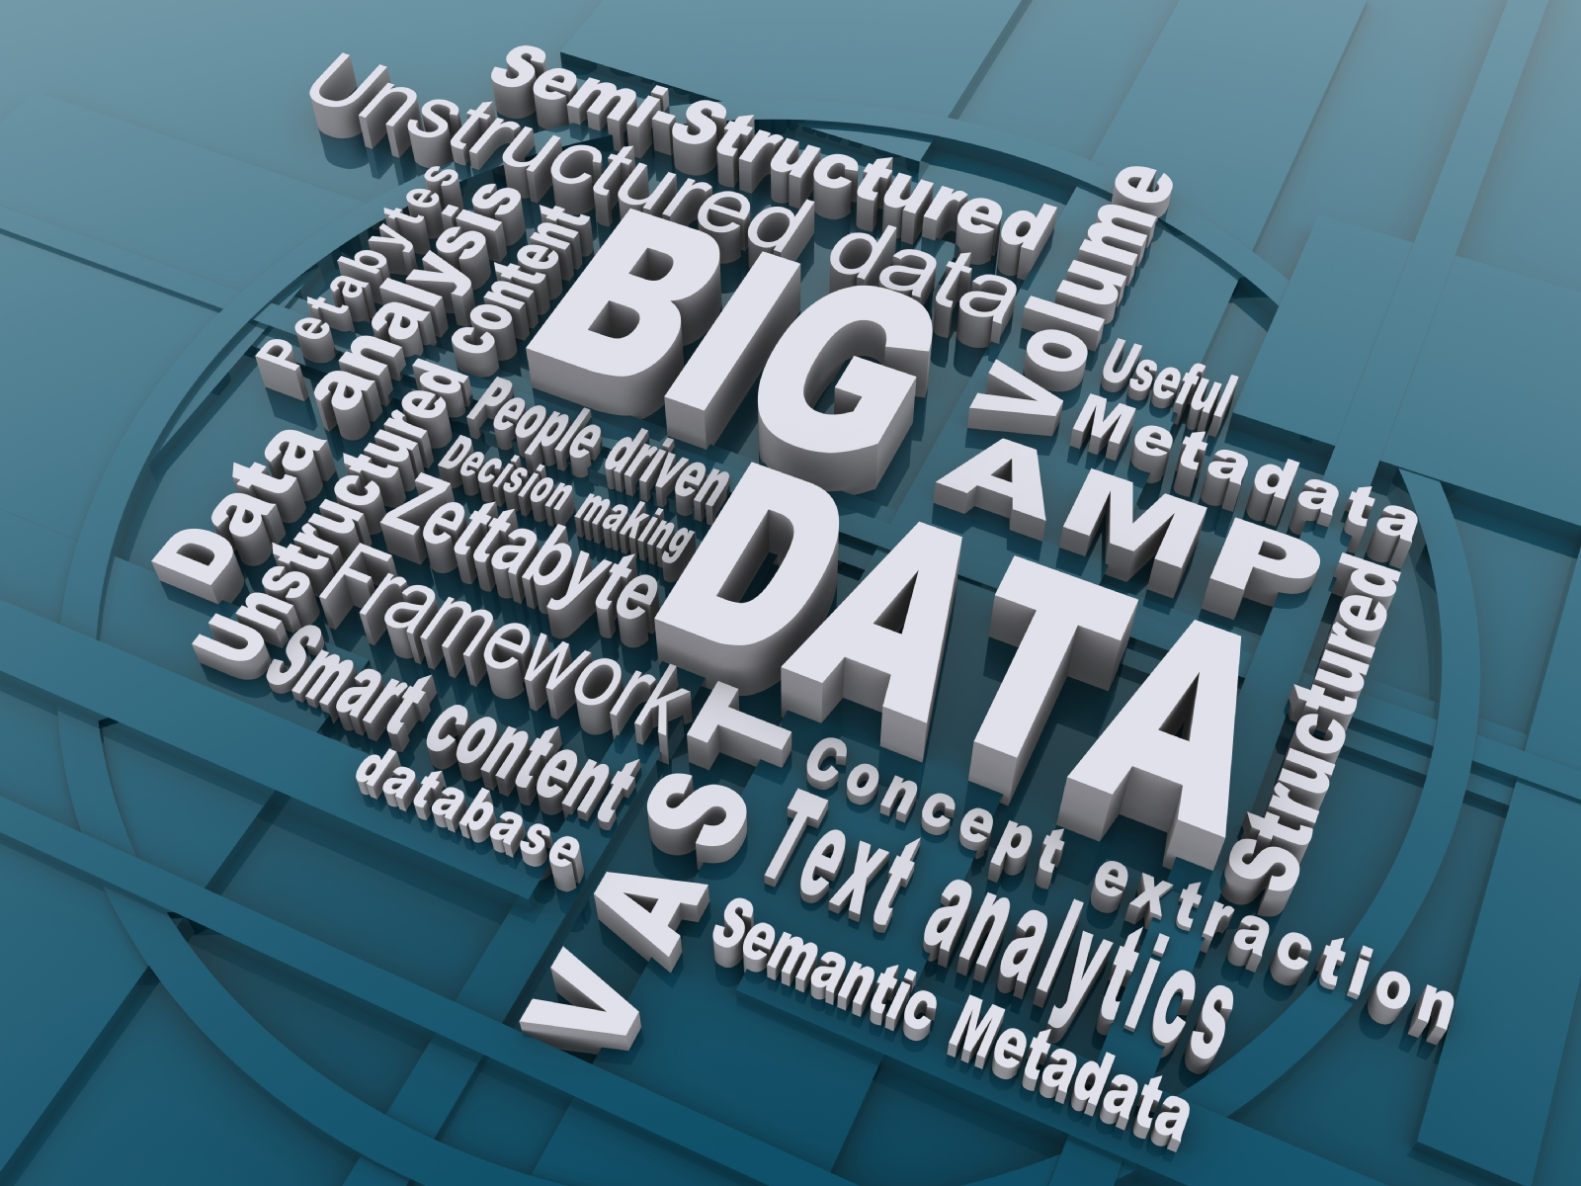
BIG DATA

Slide 10
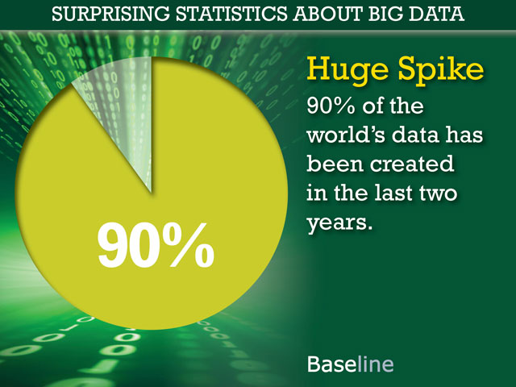
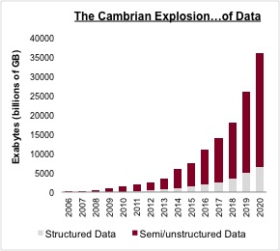
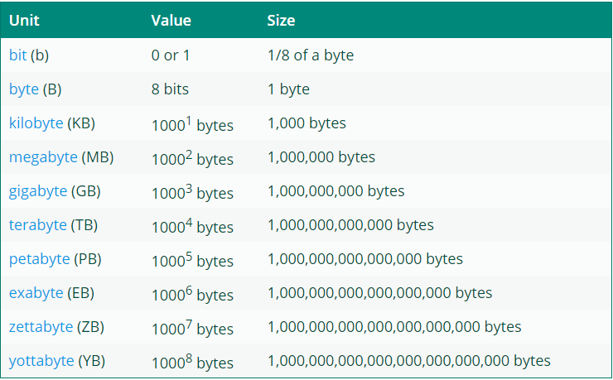

The explosion of data

Slide 11
Data is everywhere

Slide 12
The explosion of data

Slide 13
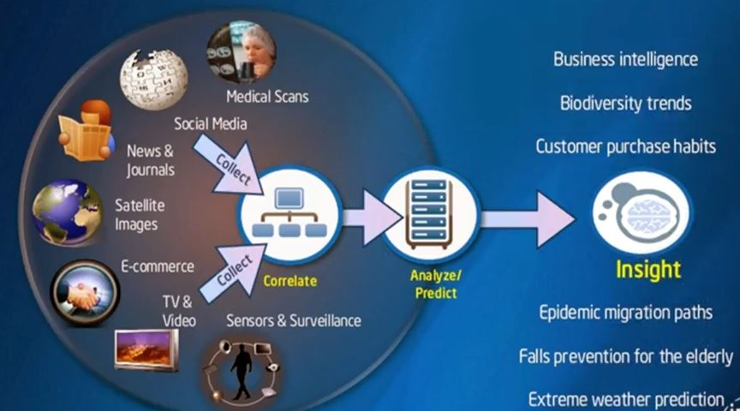
What should we do with the data

Slide 14


Slide 15
What is BIG DATA?
‘Big Data’ is similar to ‘small data’, but bigger in size
Represents analytic and data management solutions that could not previously be supported because of:
Technology limitations – poor performance,
inadequate analytic capabilities, etc.
High hardware and software costs
Incomplete or limited data for generating the required solutions

Slide 16
Characteristics of big data (V3)
Volume–challenging to load and process (how to index, retrieve)
Variety–different data types and degree of structure (how to query semi-structured data)
Velocity–real-time processing influenced by rate of data arrival

Slide 17
Characteristics of big data (V10)
Volume: tonnabytes
Variety: dimensionality
Velocity: high rate of data
Veracity: necessary and sufficient data
Validity: data quality
Value: business value, ROI
Variability: dynamic
Venue: location
Vocabulary: semantics
Vagueness: confusion

Slide 18
Data Science

Slide 19
Data Science
Interdisciplinary field using techniques and theories from many fields, including math, statistics, data engineering, pattern recognition and learning, advanced computing, visualization, uncertainty modelling, data warehousing, and high performance computing with the goal of extracting meaning from data and creating data products.
Data science seeks to use all available and relevant data to effectively tell a story that can be easily understood by non-practitioners.
Synonyms: competitive intelligence, business analytics

Slide 20
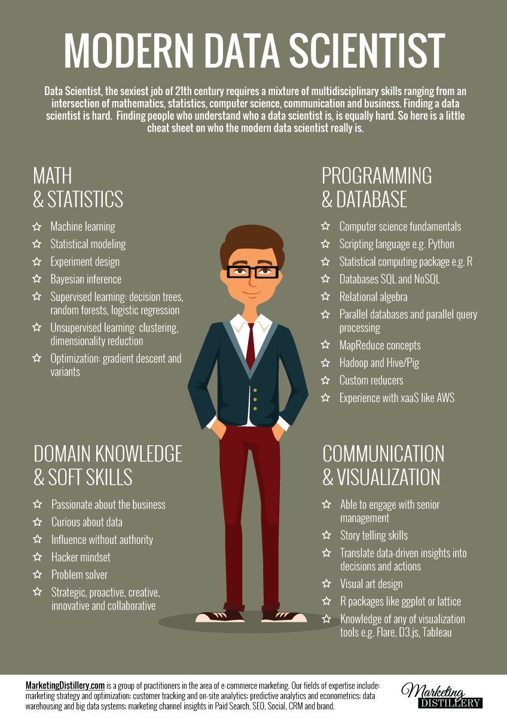

Slide 21
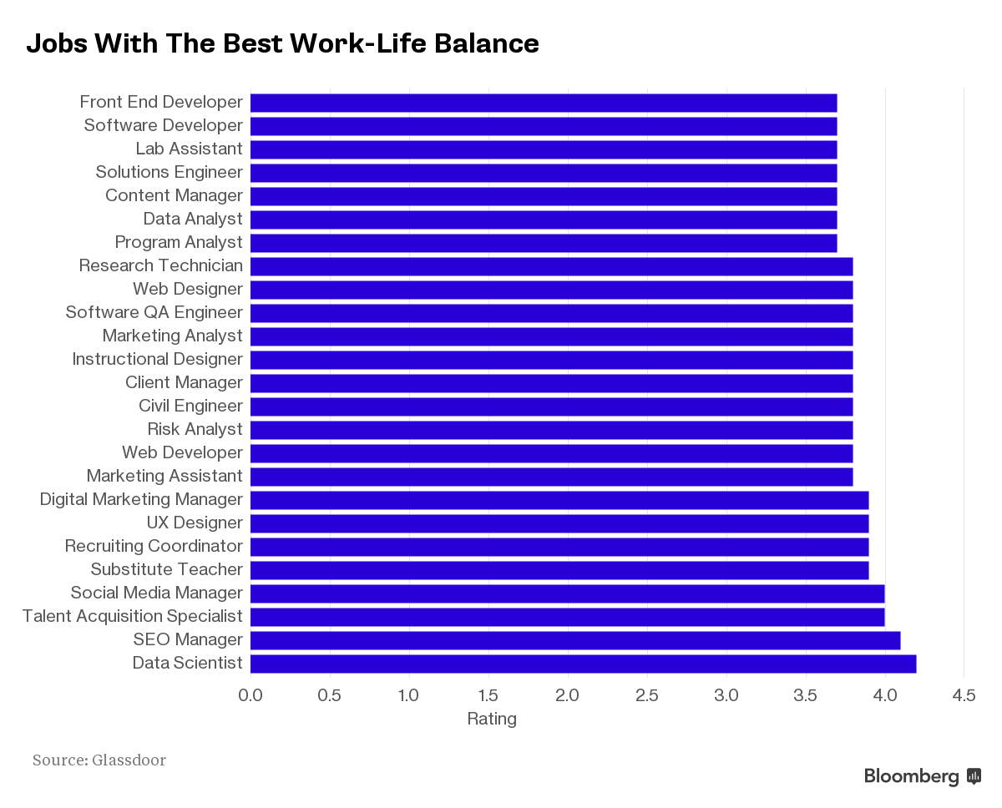
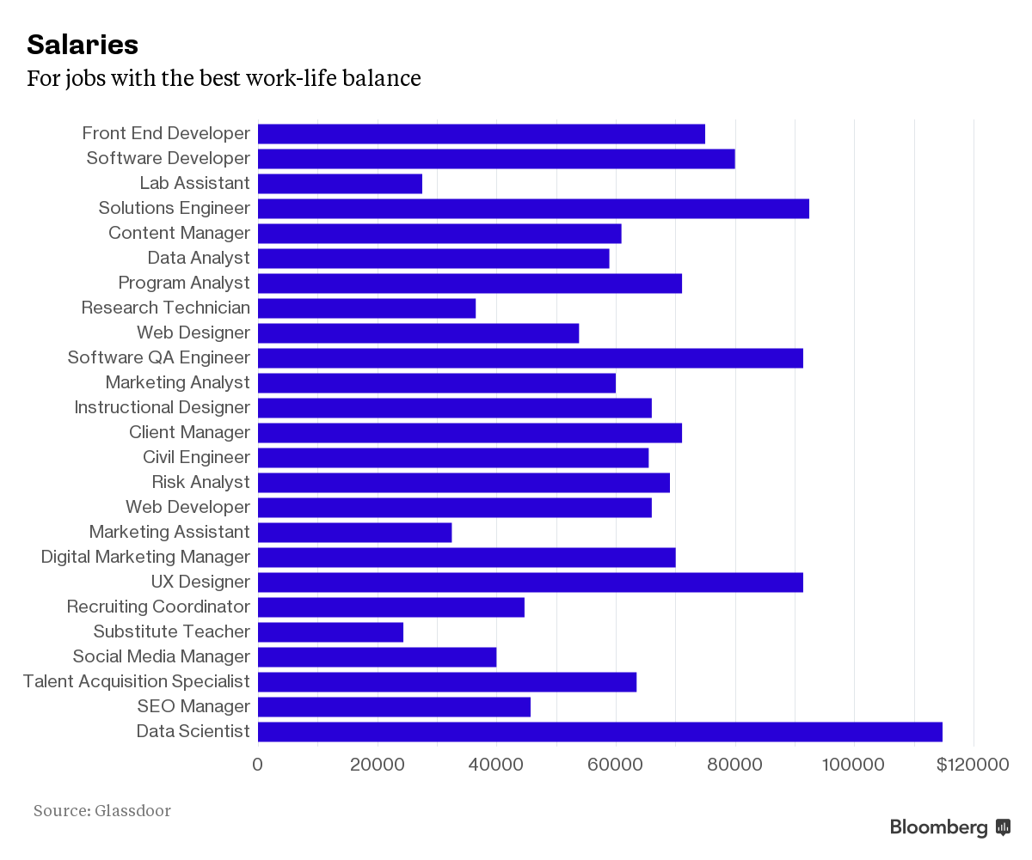
Data scientist

Slide 22


Slide 23
Applications
Behavioural analytics
Optimise funnel conversion
Customer segmentation
Predictive support

Slide 24
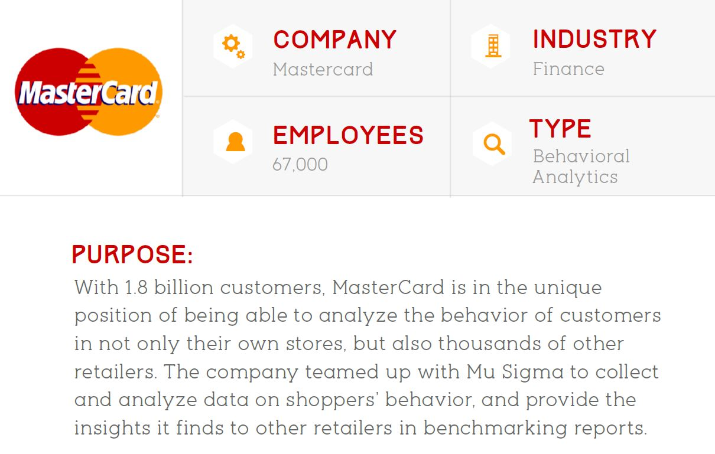
Behavioural analytics

Slide 25
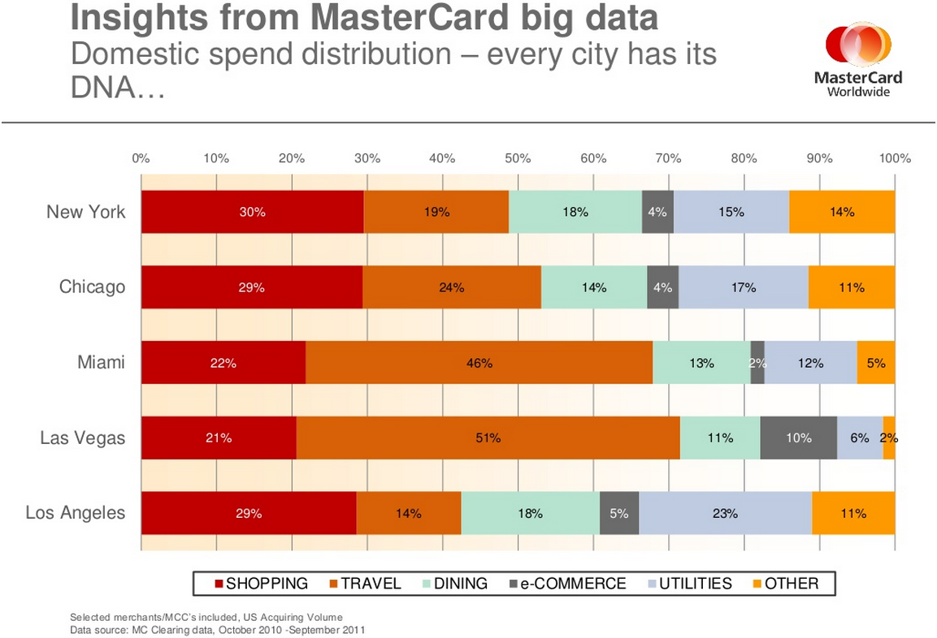

Slide 26
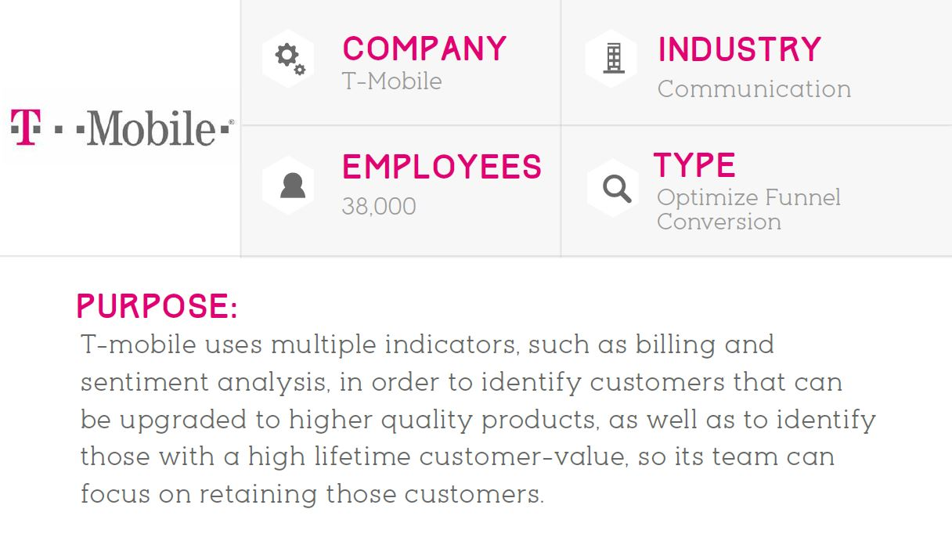
Optimise funnel conversion

Slide 27
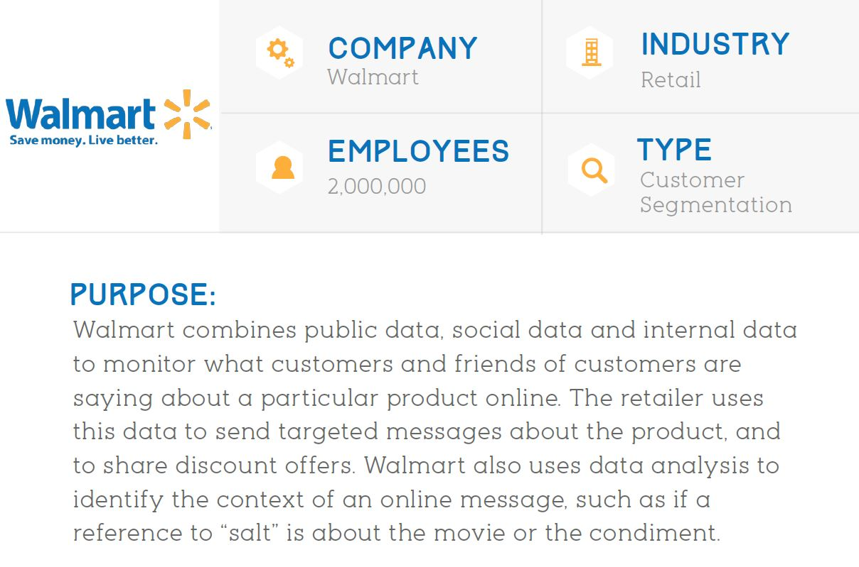
Customer segmentation

Slide 28
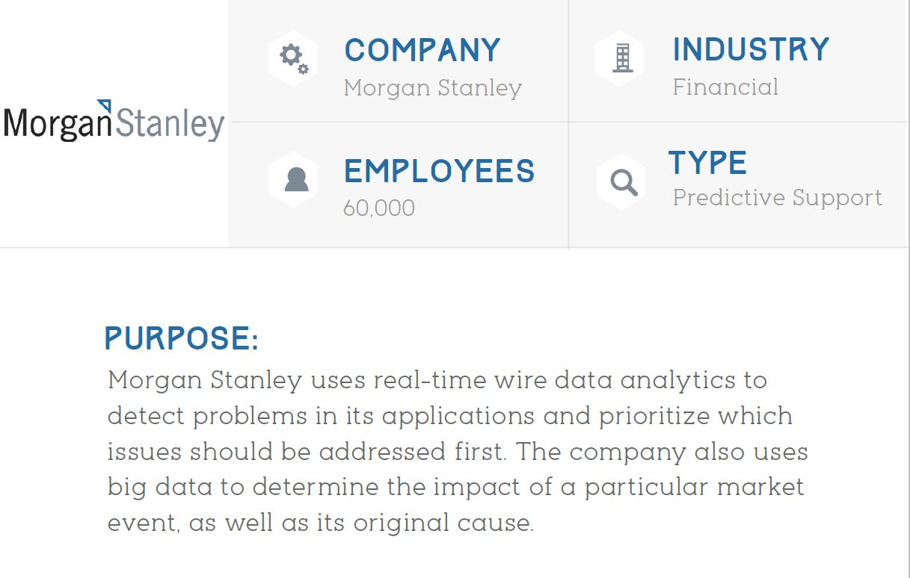
Predictive Support

Slide 29
Summary
Course outline
Big data & data science
Big data characteristics/challenges
Big data analytic use cases

Slide 30
References
This slides use information from multiple sources in the internet, some of them are listed below. We use the resources for teaching purposes only.
www.Slideshare.com
www.wikipedia.com
www.computereducation.org
https://www.coursera.org/
https://datafloq.com/

Slide 31
Thank You.

